Slide 1
Cover Crops for the Home Gardener
Jared Coppess, District Administrator

Slide 2
Getting Started
Excellent, long-term tool for improving soil productivity
Extend the “green period” in our garden, reduce the “brown gap”
Cover crops make better use of sunlight and water resources
Benefits that happen when using a cover crop:
Photosynthesis
Exude carbon into soil feeding microorganism & improving soil quality
Scavenge nutrients that otherwise would be lost

Slide 3
Just using a cover crop doesn’t always guarantee we are doing it correctly!

Slide 4
Choosing Cover Crops
What is your objective?
Different cover crop species provide different benefits. Choose the benefits that best match your needs.
How much time is needed for the cover crop?
Understand how much of the growing season is left. The amount of time needed by a cover crop to be a benefit varies by species.
Where are you located?
Climate, soils and other growing conditions affect cover crops just like any other garden plant.
What are the types and drainage characteristics
of your soils?
Some cover crops tolerate wet or droughty
conditions.

Slide 5
Benefits of Cover Crops
Nitrogen Source
Legumes fix atmospheric nitrogen. About half of N should be available for following plant in 1-2 months.
Nitrogen Scavenger
Growing roots of all cover crops take up residual soil nitrate. Some of scavenged N will be available to next plant while rest helps build soil organic matter.
Soil Builder, Subsoil Loosener, Topsoil Loosener
Roots feed micros, micros produce polysaccharides that stabilize soil. Deep roots improve permeability. Taproots may penetrate compact layers. Channels loosen topsoil and subsoil.
Erosion Preventer, Lasting Residue
Protects against wind & water erosion.
Weed Fighter
Suppress weeds through competition, shading,
or allelopathy (organic compounds with
negative impacts).

Slide 6
Weed Suppression

Slide 7
Benefits of Cover Crops
Grasses (Oats, Cereal Rye, Annual Rye, Barley, Wheat)
Increase soil organic matter, recycle excess nutrients, reduce soil compaction.
Legumes (Clovers, Winter Pea, Sunnhemp)
Produces nitrogen.
Brassicas (Radish, Rapeseed)
Loosen the soil, recycle nutrients, suppress weeds.
Non-Legume Broadleaf (Buckwheat,
Phacelia)
Suppress insects, disease & weeds or
attract beneficials

Slide 8
Termination
Don’t overwhelm yourself the first time out!
Methods of Termination:
Freeze
Mechanical Pass (Till, Mow, Roll, Crimp)
Herbicides
Understand what is necessary to terminate your cover so it doesn’t impact your garden’s production.
If this is your first time using cover crops, winter kill options are the best.
If you have used them before, experiment
some.

Slide 9
Cover Crop Seed for Sale
Darke SWCD offers 2 cover crop mixes for the Home Gardener! Only $3 per pound. 1# can cover roughly 640-700 sq. ft.
Fall Mix (80% Oats & 20% Radish)
Oats – very rapid growth, good for short windows, winter kill, allelopathic weed control, good N scavenger. 6-8 wks before frost.
Radish – Excellent for breaking up compaction, nutrient scavenger, winter kill (~22 degrees). 3-10 wks before frost.
Winter Mix (90% Cereal Rye & 10% Radish)
Cereal Rye – easy to establish, very winter hardy, can be planted later in the fall. Good bedding for pumpkins. Aug-Dec.
Radish – Excellent for breaking up compaction, nutrient
scavenger, winter kill (~22 degrees). 3-10 wks before frost.

Slide 10
Fall Mix – Oats & Radish

Slide 11
Winter Mix – Cereal Rye & Radish

Slide 12
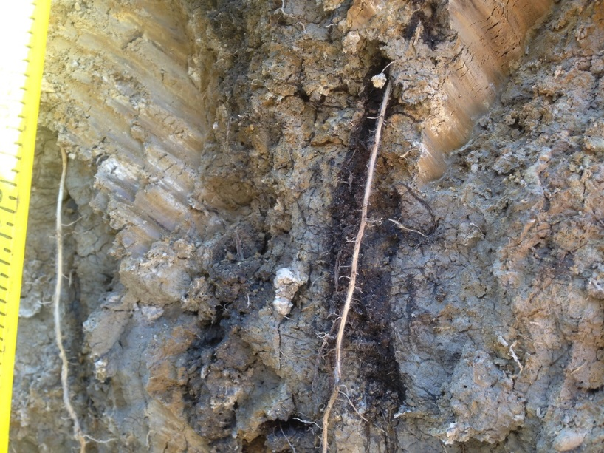
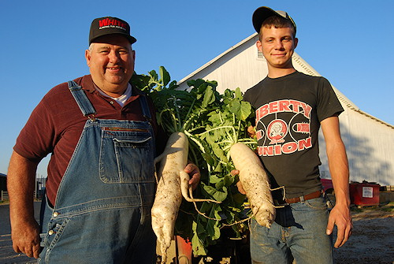
THANK YOU
Darke SWCD
1117 Southtowne Ct.
Greenville, OH 45331
Jared Coppess
937-548-1715, x 3
jared.coppess@darkeswcd.com

